Slide 1
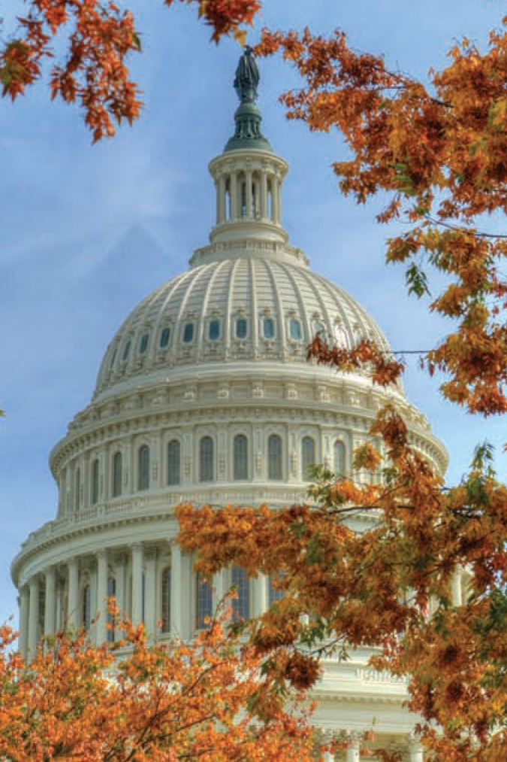
A Numerical Evaluation of the Accuracy of Influence Maximization Algorithms
3rd International Workshop on MAISoN, Santa Clara October 2, 2019
Hautahi Kingi IMPAQ International
Li-An Daniel Wang Sam Houston State University
Tom Shafer Elder Research
Minh Huynh IMPAQ International
Mike Trinh IMPAQ International
Aaron Heuser IMPAQ International
George Rochester U.S. Food and Drug Administration
Antonio Paredes U.S. Food and Drug Administration
Latest Paper Version: hautahi.com/work
Code: github.com/hautahi/IM-Evaluation

Slide 2
Agenda
Introduction to Influence Maximization

Slide 3
Agenda
Introduction to Influence Maximization
Approximate (1 - 1/e) Solutions
Greedy
Reverse Influence Sampling

Slide 4
Agenda
Introduction to Influence Maximization
Approximate (1 - 1/e) Solutions
Greedy
Reverse Influence Sampling
Exact Solution

Slide 5
Agenda
Introduction to Influence Maximization
Approximate (1 - 1/e) Solutions
Greedy
Reverse Influence Sampling
Exact Solution
Results

Slide 6
Influence Maximization
Which nodes are most influential?

Slide 7
Influence Maximization
Which nodes are most influential?
Applications: Viral Marketing, Epidemiology, Fault Monitoring, Public Health

Slide 8
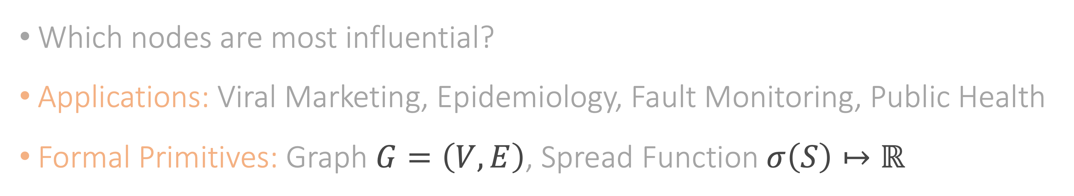
Influence Maximization
Which nodes are most influential?
Applications: Viral Marketing, Epidemiology, Fault Monitoring, Public Health
Formal Primitives: Graph $G=\left(V,E\right)$, Spread Function $σ\left(S\right)↦ℝ$

Slide 9
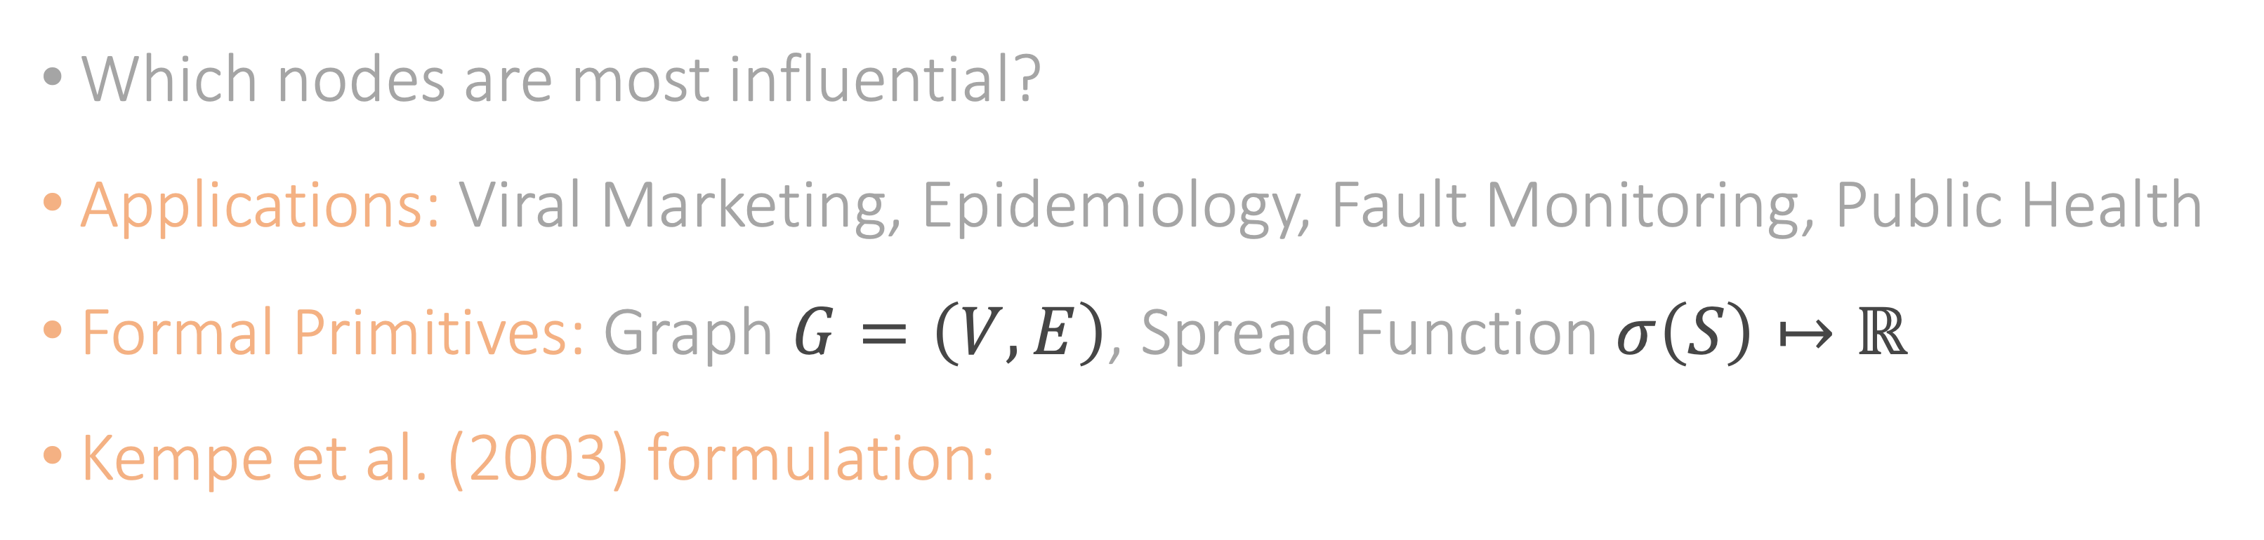
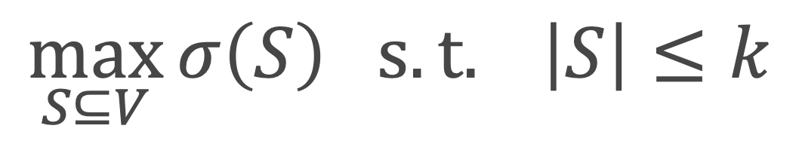
Influence Maximization
Which nodes are most influential?
Applications: Viral Marketing, Epidemiology, Fault Monitoring, Public Health
Formal Primitives: Graph $G=\left(V,E\right)$, Spread Function $σ\left(S\right)↦ℝ$
Kempe et al. (2003) formulation:
$$\max_{S⊆V}{σ\left(S\right) s.t. \left|S\right|≤k}$$

Slide 10
Influence Maximization

Slide 11
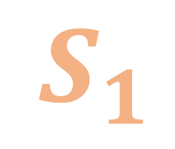
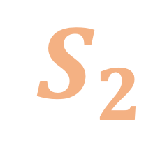
Influence Maximization
$$S_{1}$$
$$S_{2}$$

Slide 12
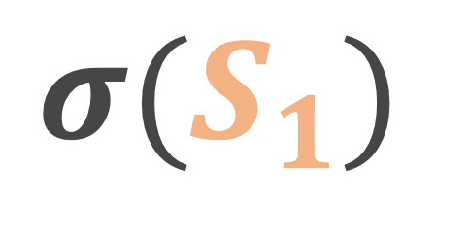
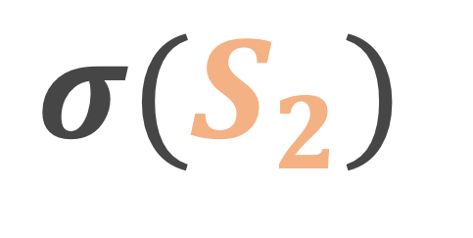
Influence Maximization
$${σ(S}_{1})$$
$${σ(S}_{2})$$

Slide 13
Influence Maximization
$${σ(S}_{1})$$
$${σ(S}_{2})$$

Slide 14
Influence Maximization
$${σ(S}_{1})$$
$${σ(S}_{2})$$

Slide 15
Influence Maximization
>
$${σ(S}_{1})$$
$${σ(S}_{2})$$

Slide 16
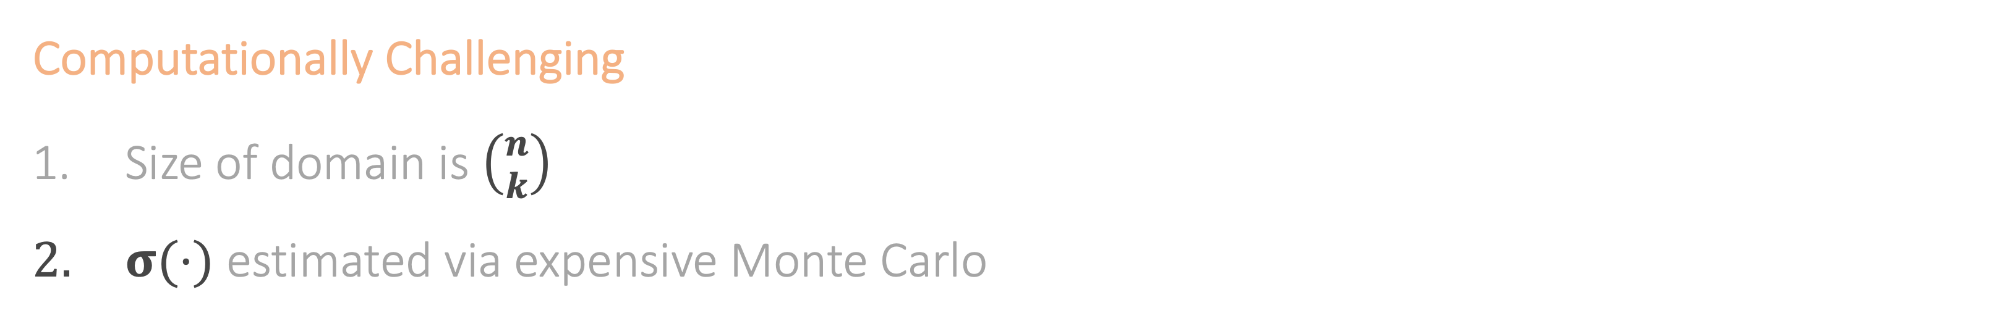
A Brief History
Computationally Challenging
Size of domain is $\left({n \atop k}\right)$
$σ(⋅)$ estimated via expensive Monte Carlo
Kempe et al. (2003)
Greedy
2003

Slide 17
A Brief History
Computationally Challenging
Size of domain is $\left({n \atop k}\right)$
$σ(⋅)$ estimated via expensive Monte Carlo
Borgs et al. (2014)
Reverse Influence Sampling
2014

Slide 18

A Brief History
Computationally Challenging
Size of domain is $\left({n \atop k}\right)$
$σ(⋅)$ estimated via expensive Monte Carlo
Us + Li et al. (2019)
Exact Solutions
2019

Slide 19
Greedy Solution

Slide 20
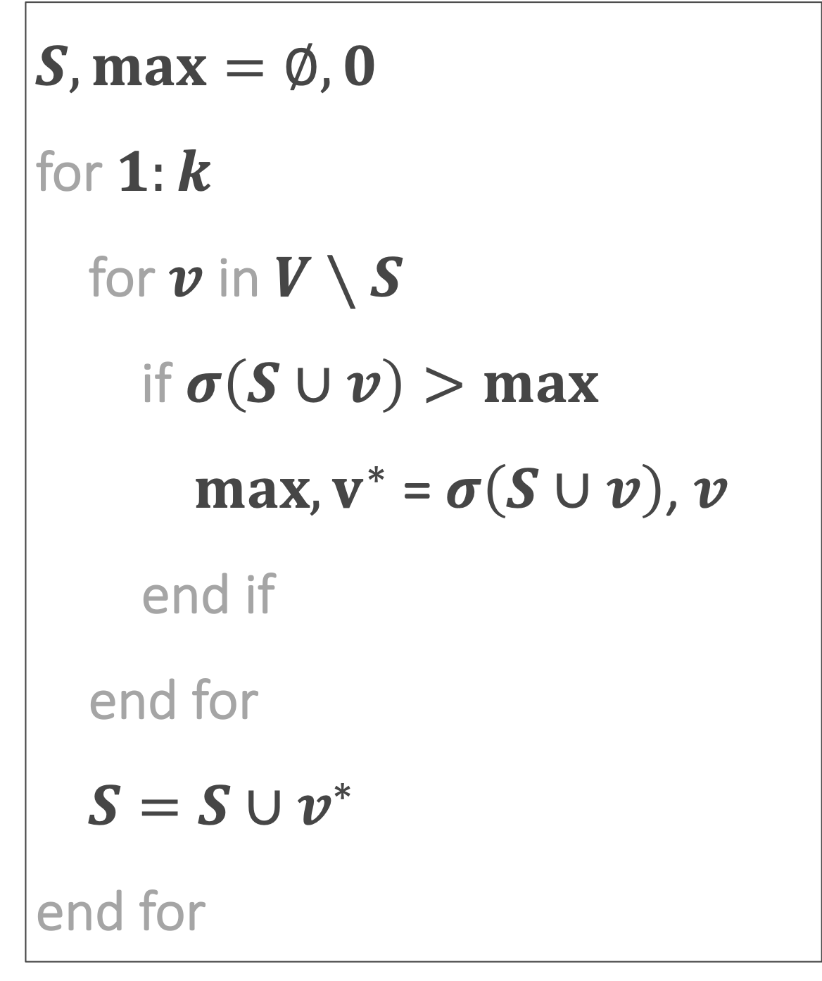
Greedy Approximation
$S, max=∅, 0$
for $1:k$
for $v$ in $V∖S$
if $σ\left(S∪v\right)>max$
$max, v^{∗}$ = $σ\left(S∪v\right)$, $v$
end if
end for
$S=S∪v^{∗}$
end for

Slide 21

Greedy Approximation
$S, max=∅, 0$
for $1:k$
for $v$ in $V∖S$
if $σ\left(S∪v\right)>max$
$max, v^{∗}$ = $σ\left(S∪v\right)$, $v$
end if
end for
$S=S∪v^{∗}$
end for
$$O(k⋅n⋅mc)$$

Slide 22

Greedy Approximation
$S, max=∅, 0$
for $1:k$
for $v$ in $V∖S$
if $σ\left(S∪v\right)>max$
$max, v^{∗}$ = $σ\left(S∪v\right)$, $v$
end if
end for
$S=S∪v^{∗}$
end for
$$O(k⋅n⋅mc)$$
$σ(⋅)$ sub-modular!

Slide 23
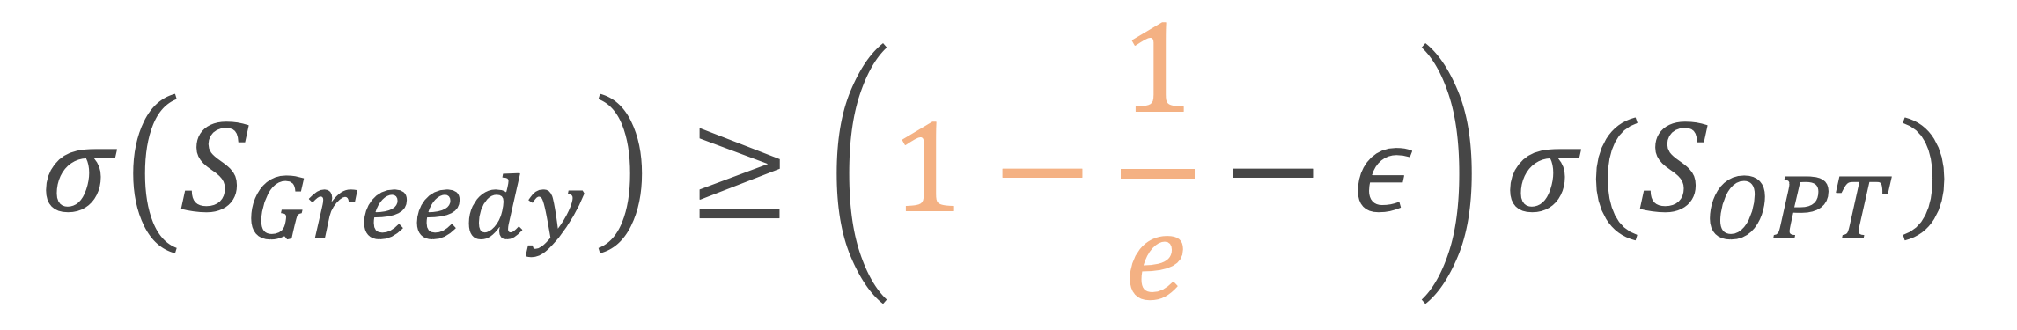
Greedy Approximation
$S, max=∅, 0$
for $1:k$
for $v$ in $V∖S$
if $σ\left(S∪v\right)>max$
$max, v^{∗}$ = $σ\left(S∪v\right)$, $v$
end if
end for
$S=S∪v^{∗}$
end for
$$O(k⋅n⋅mc)$$
$σ(⋅)$ sub-modular!
$$σ\left(S_{Greedy}\right)≥\left(1−\frac{1}{e}−ε\right)σ(S_{OPT})$$

Slide 24
Greedy Approximation
$S, max=∅, 0$
for $1:k$
for $v$ in $V∖S$
if $σ\left(S∪v\right)>max$
$max, v^{∗}$ = $σ\left(S∪v\right)$, $v$
end if
end for
$S=S∪v^{∗}$
end for
$$O(k⋅n⋅mc)$$
$σ(⋅)$ sub-modular!
$$σ\left(S_{Greedy}\right)≥\left(1−\frac{1}{e}−ε\right)σ(S_{OPT})$$
submodularity

Slide 25
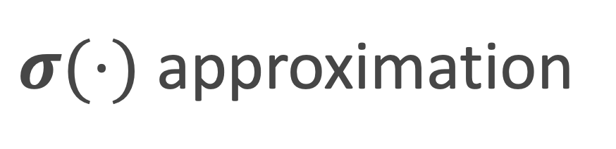
Greedy Approximation
$S, max=∅, 0$
for $1:k$
for $v$ in $V∖S$
if $σ\left(S∪v\right)>max$
$max, v^{∗}$ = $σ\left(S∪v\right)$, $v$
end if
end for
$S=S∪v^{∗}$
end for
$$O(k⋅n⋅mc)$$
$σ(⋅)$ sub-modular!
$$σ\left(S_{Greedy}\right)≥\left(1−\frac{1}{e}−ε\right)σ(S_{OPT})$$
submodularity
$σ(⋅)$ approximation

Slide 26
Reverse Influence Sampling

Slide 27
Random Reverse Reachable Sets

Slide 28
Random Reverse Reachable Sets

Slide 29
Random Reverse Reachable Sets

Slide 30
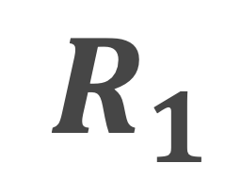
Random Reverse Reachable Sets
$$R_{1}$$

Slide 31
Random Reverse Reachable Sets
$$R_{1}$$

Slide 32
Random Reverse Reachable Sets
$$R_{1}$$

Slide 33
Random Reverse Reachable Sets
$$R_{1}$$

Slide 34
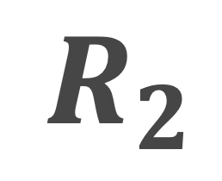
Random Reverse Reachable Sets
$$R_{1}$$
$$R_{2}$$

Slide 35
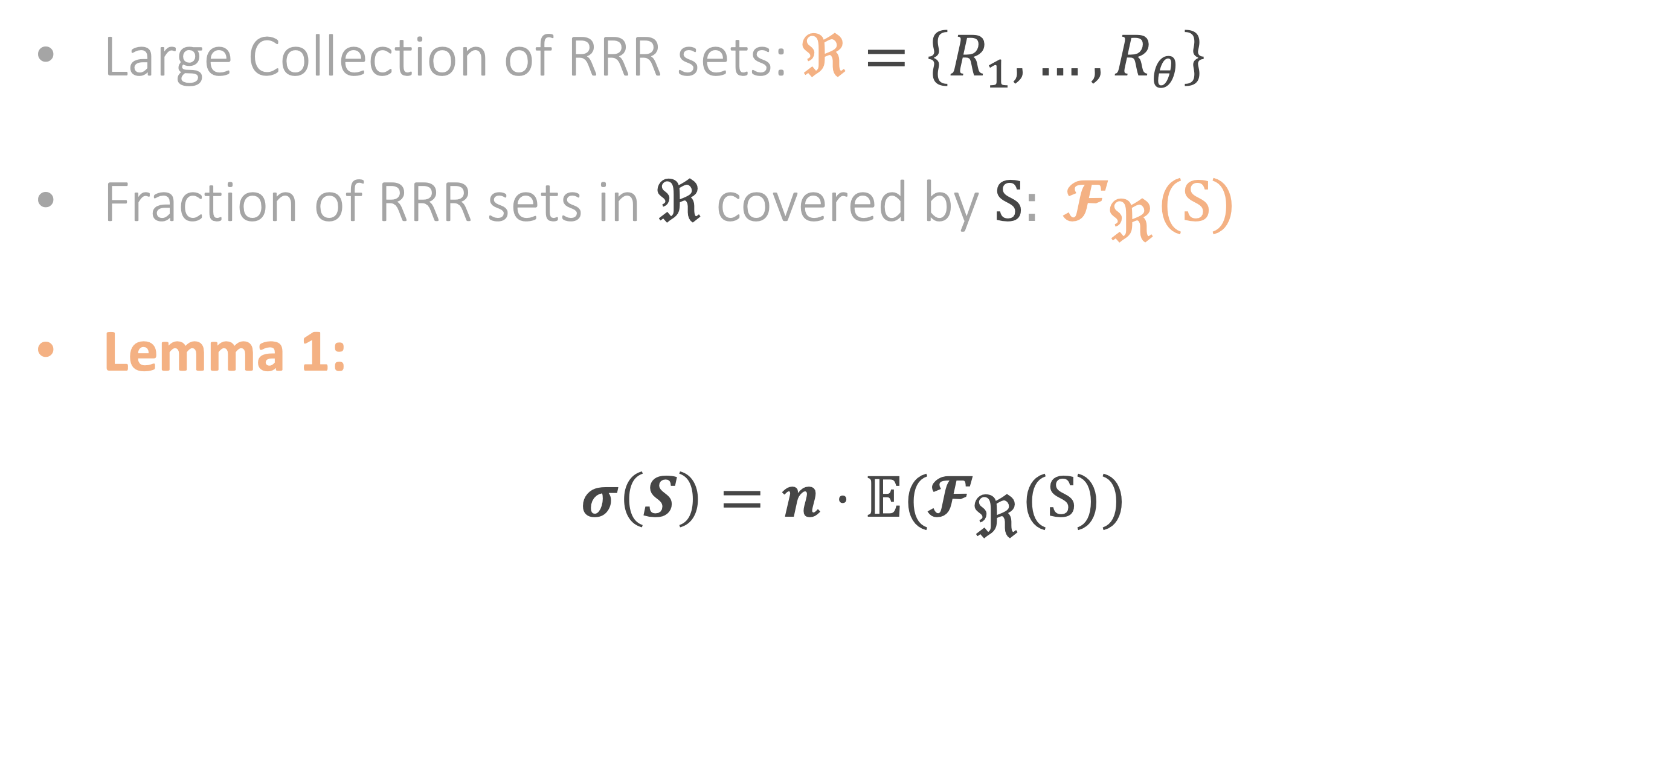
Reverse Influence Sampling
Large Collection of RRR sets: $\text{ℜ}=\left\{R_{1},…, R_{θ}\right\}$
Fraction of RRR sets in $\text{ℜ}$ covered by$\text{S}: 𝓕_{\text{ℜ}}\text{(}\text{S}\text{)}$
Lemma 1:
$$σ\left(S\right)=n⋅𝔼(𝓕_{\text{ℜ}}\text{(}\text{S}\text{))}$$

Slide 36
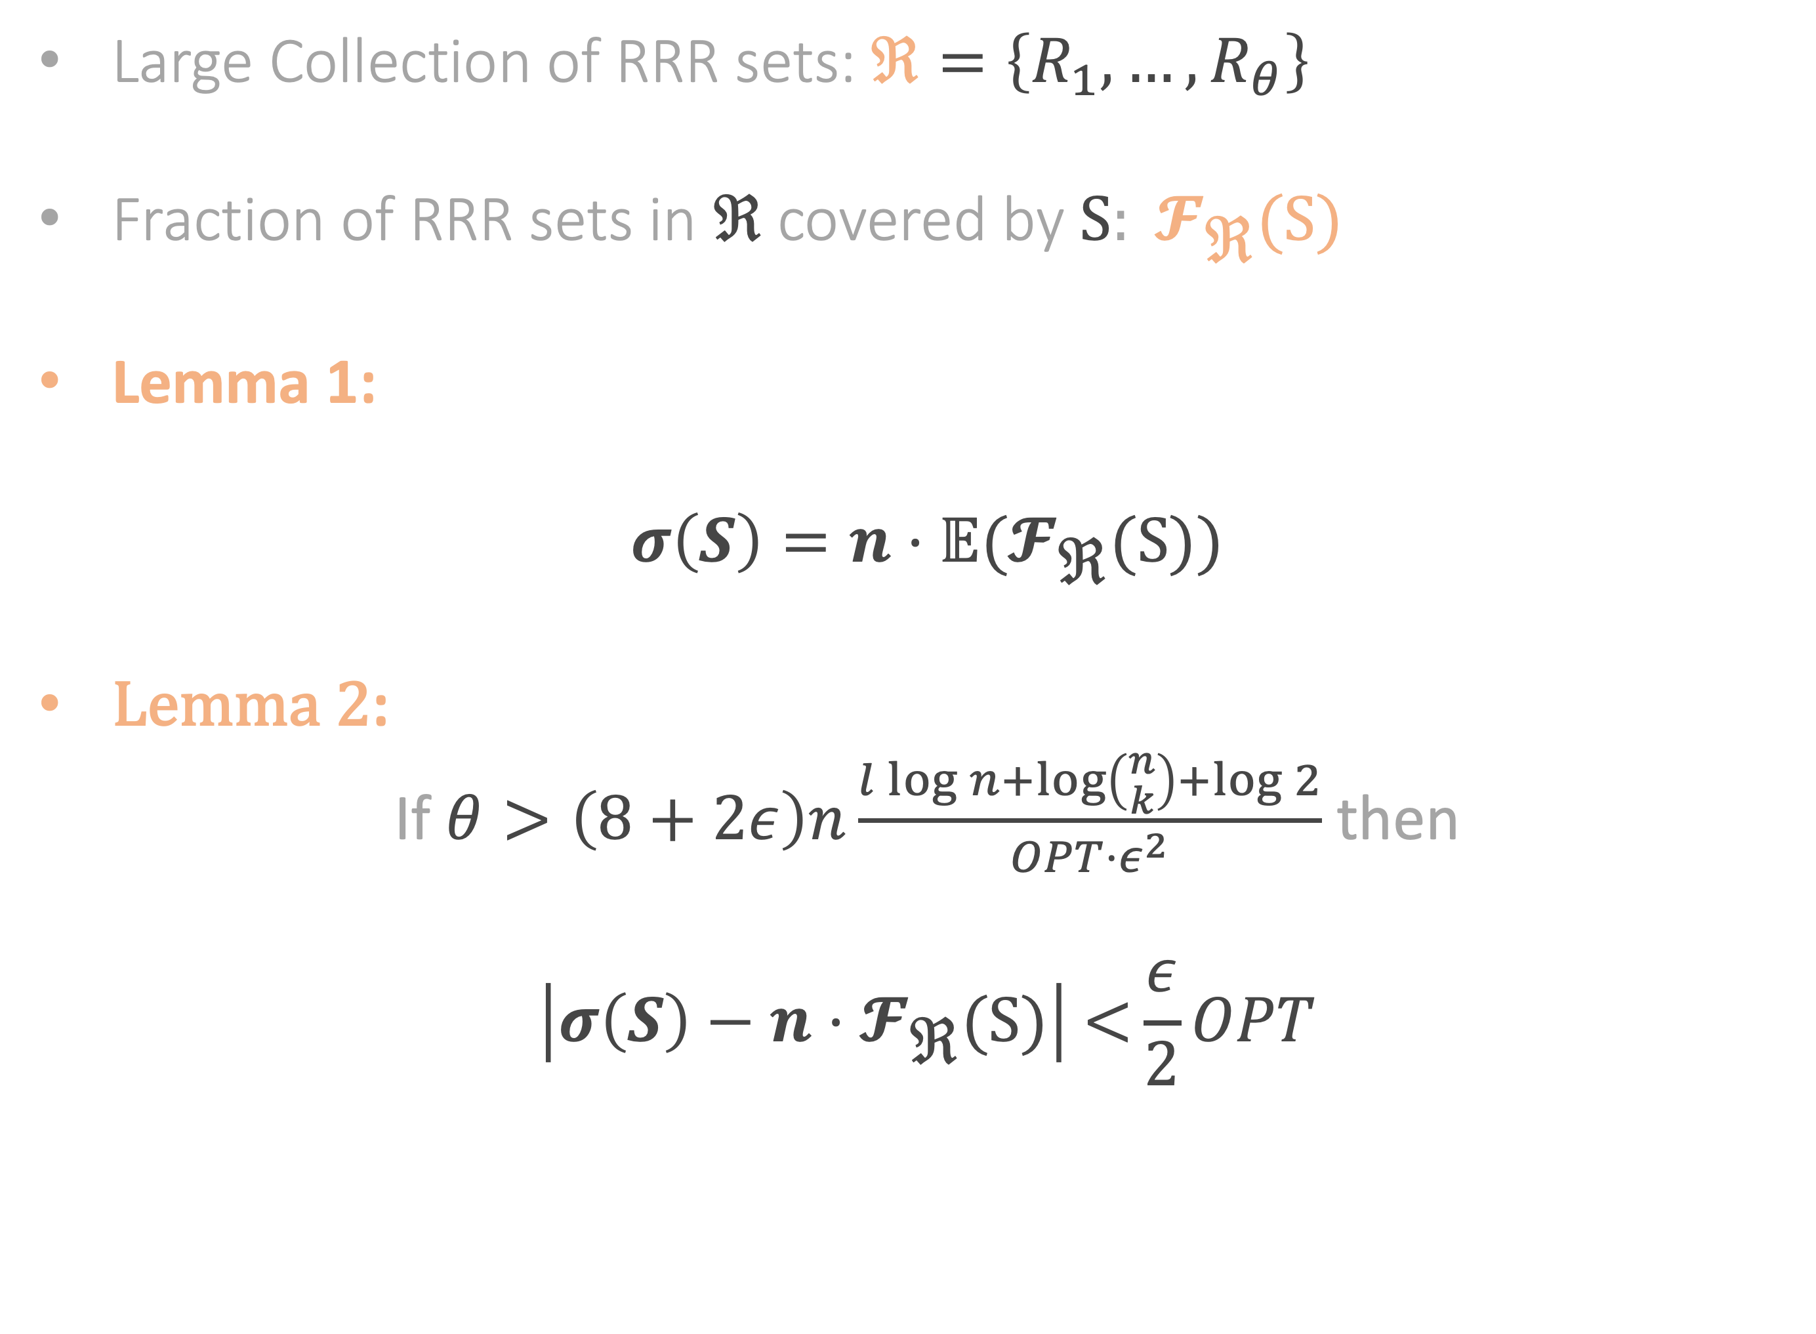
Reverse Influence Sampling
Large Collection of RRR sets: $\text{ℜ}=\left\{R_{1},…, R_{θ}\right\}$
Fraction of RRR sets in $\text{ℜ}$ covered by$\text{S}: 𝓕_{\text{ℜ}}\text{(}\text{S}\text{)}$
Lemma 1:
$$σ\left(S\right)=n⋅𝔼(𝓕_{\text{ℜ}}\text{(}\text{S}\text{))}$$
Lemma 2:
If $θ>\left(8+2ε\right)n\frac{l\log{n}+\log\left({n \atop k}\right)+log{2}}{OPT⋅ε^{2}}$ then
$$\left|σ\left(S\right)−n⋅𝓕_{\text{ℜ}}\text{(}\text{S}\text{)}\right| \text{<}\frac{ε}{2}OPT$$

Slide 37
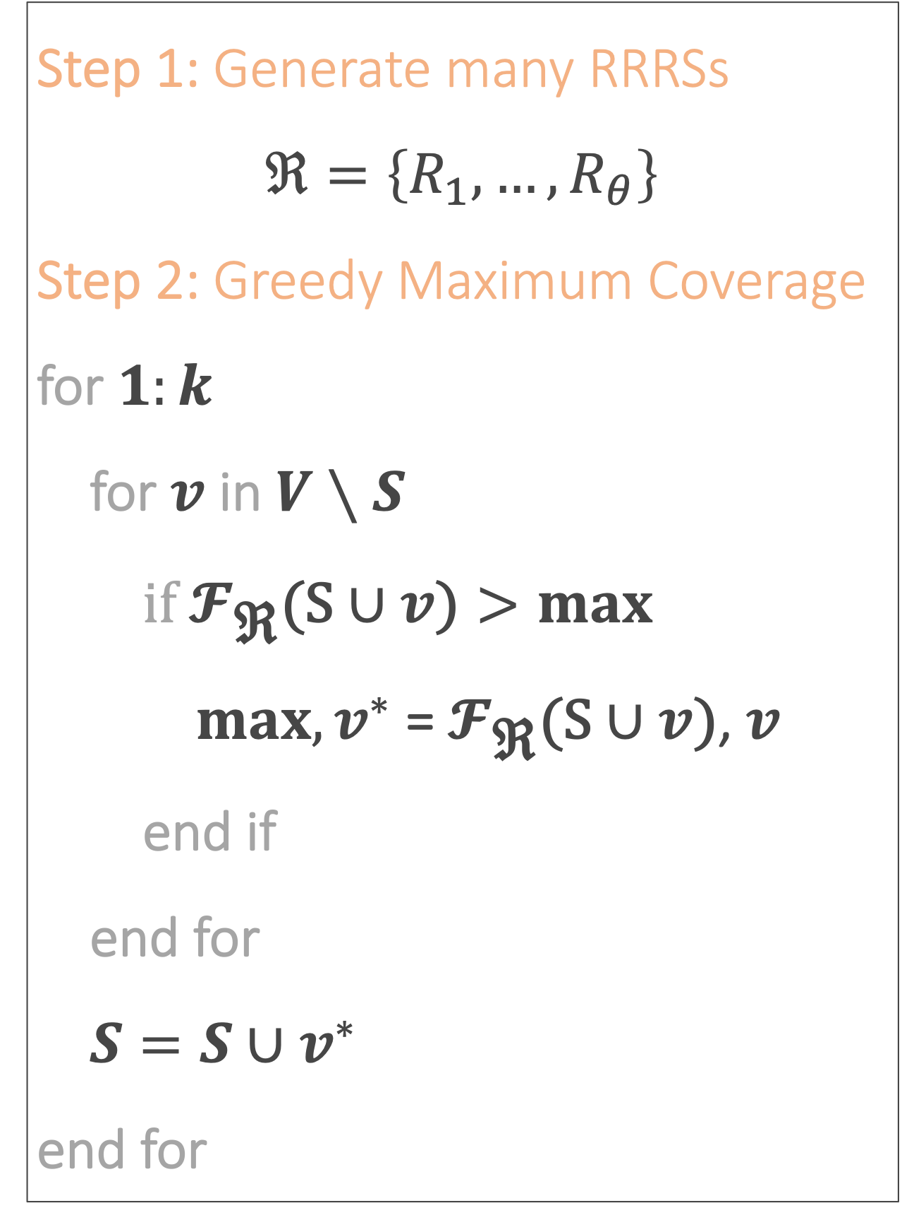
RIS Approximation
Step 1: Generate many RRRSs
$$\text{ℜ}=\left\{R_{1},…, R_{θ}\right\}$$
Step 2: Greedy Maximum Coverage
for $1:k$
for $v$ in $V∖S$
$if{ 𝓕}_{\text{ℜ}}\text{(}\text{S}∪v\text{)}>max$
$max, v^{∗}$ =${ 𝓕}_{\text{ℜ}}\text{(}\text{S}∪v\text{)}$, $v$
end if
end for
$S=S∪v^{∗}$
end for

Slide 38

RIS Approximation
Step 1: Generate many RRRSs
$$\text{ℜ}=\left\{R_{1},…, R_{θ}\right\}$$
Step 2: Greedy Maximum Coverage
for $1:k$
for $v$ in $V∖S$
$if{ 𝓕}_{\text{ℜ}}\text{(}\text{S}∪v\text{)}>max$
$max, v^{∗}$ =${ 𝓕}_{\text{ℜ}}\text{(}\text{S}∪v\text{)}$, $v$
end if
end for
$S=S∪v^{∗}$
end for
$$O(k⋅n+θ)$$

Slide 39

RIS Approximation
Step 1: Generate many RRRSs
$$\text{ℜ}=\left\{R_{1},…, R_{θ}\right\}$$
Step 2: Greedy Maximum Coverage
for $1:k$
for $v$ in $V∖S$
$if{ 𝓕}_{\text{ℜ}}\text{(}\text{S}∪v\text{)}>max$
$max, v^{∗}$ =${ 𝓕}_{\text{ℜ}}\text{(}\text{S}∪v\text{)}$, $v$
end if
end for
$S=S∪v^{∗}$
end for
$$O(k⋅n+θ)$$
${ 𝓕}_{\text{ℜ}}(⋅)$ sub-modular!

Slide 40
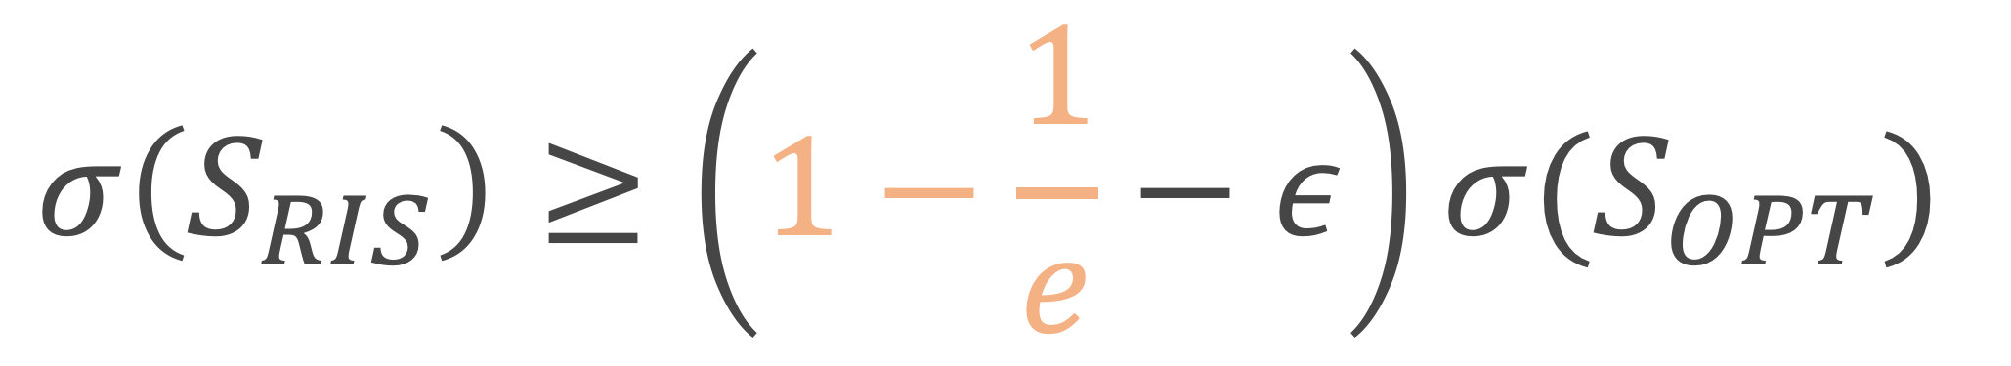
RIS Approximation
Step 1: Generate many RRRSs
$$\text{ℜ}=\left\{R_{1},…, R_{θ}\right\}$$
Step 2: Greedy Maximum Coverage
for $1:k$
for $v$ in $V∖S$
$if{ 𝓕}_{\text{ℜ}}\text{(}\text{S}∪v\text{)}>max$
$max, v^{∗}$ =${ 𝓕}_{\text{ℜ}}\text{(}\text{S}∪v\text{)}$, $v$
end if
end for
$S=S∪v^{∗}$
end for
$$O(k⋅n+θ)$$
${ 𝓕}_{\text{ℜ}}(⋅)$ sub-modular!
$$σ\left(S_{RIS}\right)≥\left(1−\frac{1}{e}−ε\right)σ(S_{OPT})$$

Slide 41
RIS - Exact

Slide 42
RIS-Exact
Step 1: Generate many RRRSs
$$\text{ℜ}=\left\{R_{1},…, R_{θ}\right\}$$
Step 2: Greedy Maximum Coverage
for $1:k$
for $v$ in $V∖S$
$if{ 𝓕}_{\text{ℜ}}\text{(}\text{S}∪v\text{)}>max$
$max, v^{∗}$ =${ 𝓕}_{\text{ℜ}}\text{(}\text{S}∪v\text{)}$, $v$
end if
end for
$S=S∪v^{∗}$
end for

Slide 43
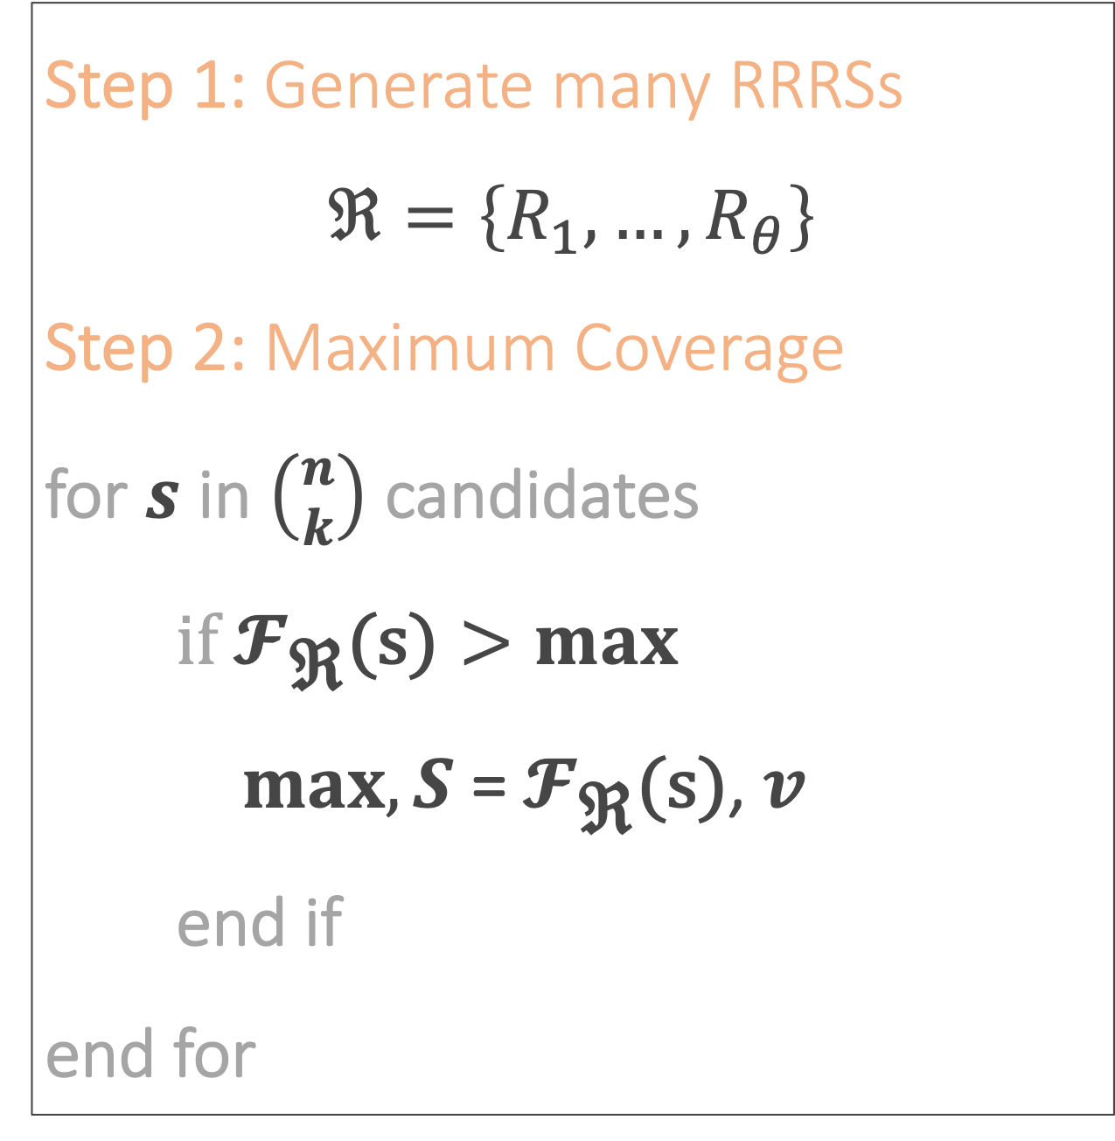
RIS-Exact
Step 1: Generate many RRRSs
$$\text{ℜ}=\left\{R_{1},…, R_{θ}\right\}$$
Step 2: Greedy Maximum Coverage
for $1:k$
for $v$ in $V∖S$
$if{ 𝓕}_{\text{ℜ}}\text{(}\text{S}∪v\text{)}>max$
$max, v^{∗}$ =${ 𝓕}_{\text{ℜ}}\text{(}\text{S}∪v\text{)}$, $v$
end if
end for
$S=S∪v^{∗}$
end for
Step 1: Generate many RRRSs
$$\text{ℜ}=\left\{R_{1},…, R_{θ}\right\}$$
Step 2: Maximum Coverage
for $s$ in $\left({n \atop k}\right)$ candidates
$if{ 𝓕}_{\text{ℜ}}\text{(}\text{s}\text{)}>max$
$max, S$ =${ 𝓕}_{\text{ℜ}}\text{(}\text{s}\text{)}$, $v$
end if
end for

Slide 44
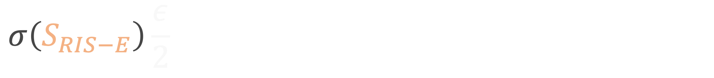
RIS-Exact Proof Sketch
$$σ\left(S_{RIS−E}\right)\frac{ε}{2}$$

Slide 45
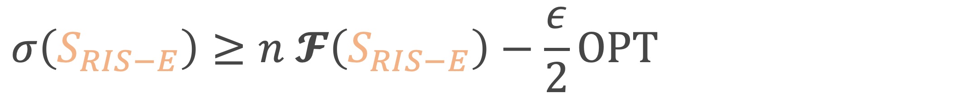
RIS-Exact Proof Sketch
$$σ\left(S_{RIS−E}\right)≥n 𝓕\left(S_{RIS−E}\right)−\frac{ε}{2}OPT$$
[Lemma]

Slide 46
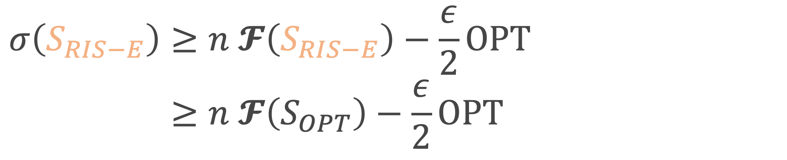

RIS-Exact Proof Sketch
$$σ\left(S_{RIS−E}\right)≥n 𝓕\left(S_{RIS−E}\right)−\frac{ε}{2}OPT \\ ≥n 𝓕\left(S_{OPT}\right)−\frac{ε}{2}OPT$$
[Lemma]
[definition of${ S}_{RIS−E}$]

Slide 47
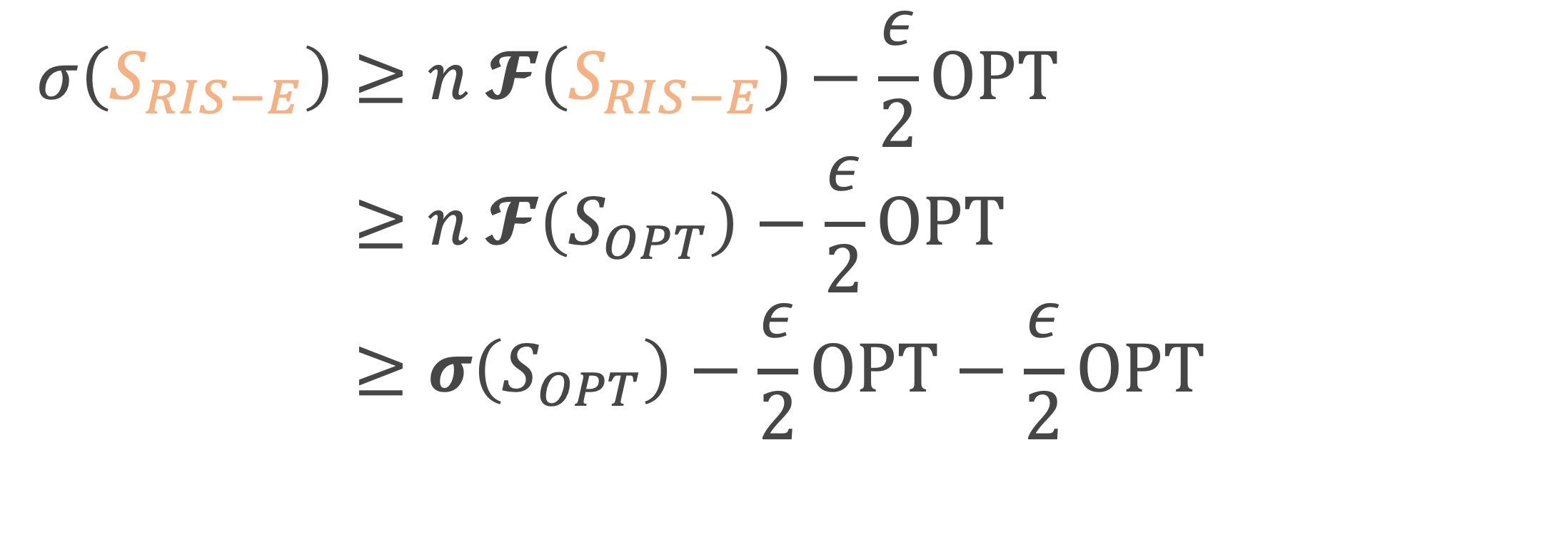
RIS-Exact Proof Sketch
$$σ\left(S_{RIS−E}\right)≥n 𝓕\left(S_{RIS−E}\right)−\frac{ε}{2}OPT \\ ≥n 𝓕\left(S_{OPT}\right)−\frac{ε}{2}OPT \\ ≥σ\left(S_{OPT}\right)−\frac{ε}{2}OPT−\frac{ε}{2}OPT$$
[Lemma]
[definition of${ S}_{RIS−E}$]
[Lemma]

Slide 48
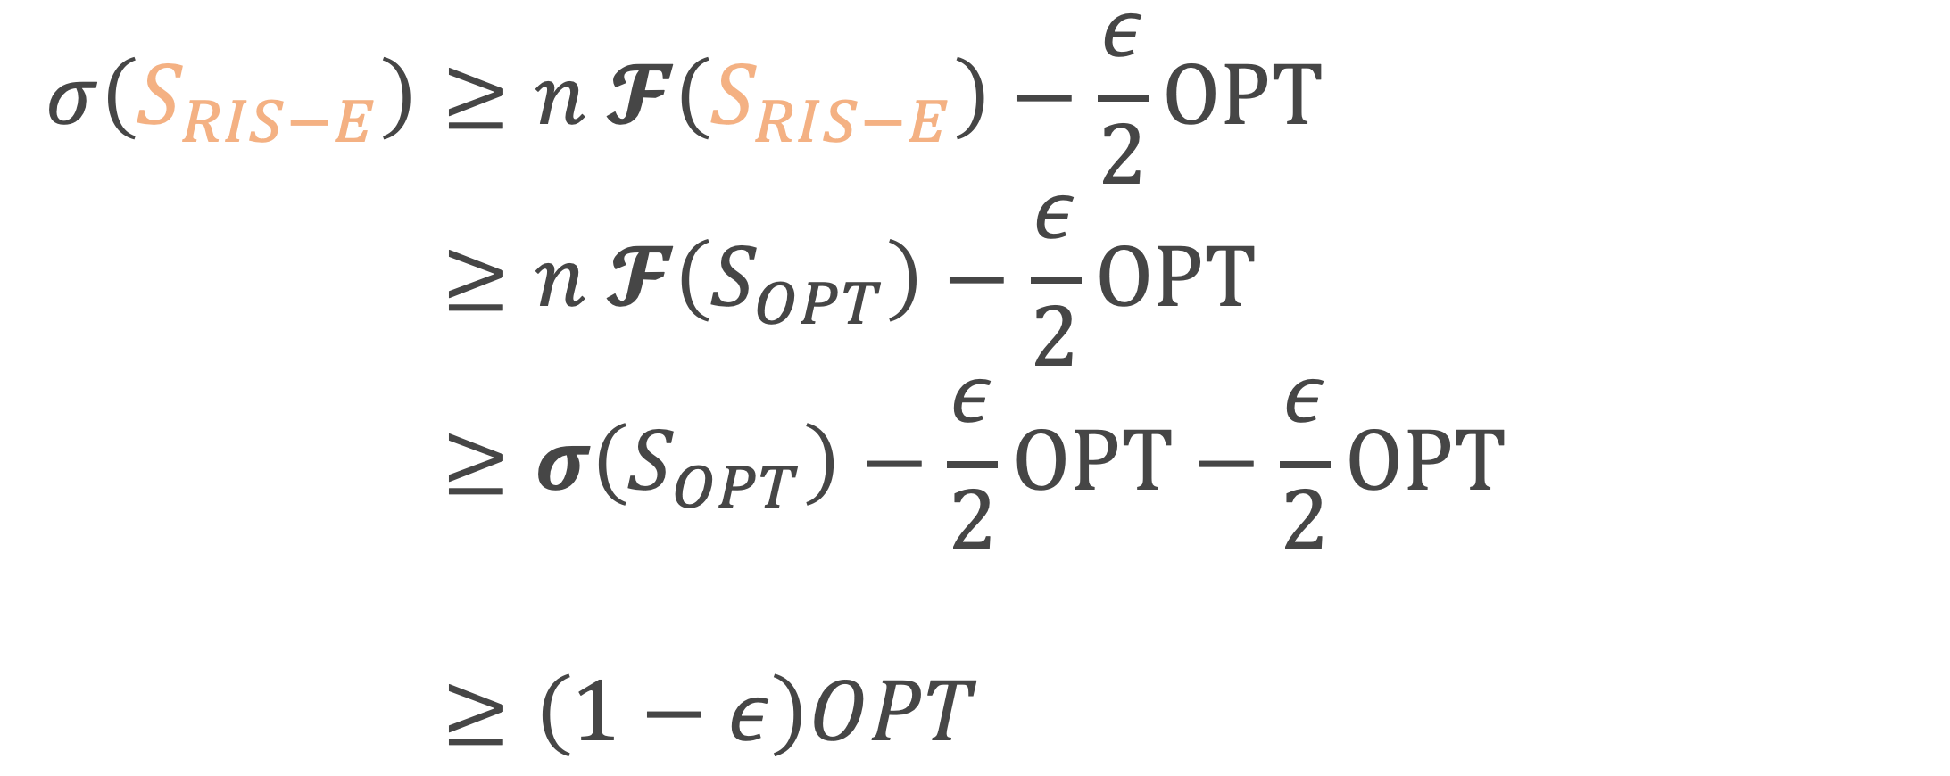
RIS-Exact Proof Sketch
$$σ\left(S_{RIS−E}\right)≥n 𝓕\left(S_{RIS−E}\right)−\frac{ε}{2}OPT \\ ≥n 𝓕\left(S_{OPT}\right)−\frac{ε}{2}OPT \\ ≥σ\left(S_{OPT}\right)−\frac{ε}{2}OPT−\frac{ε}{2}OPT \\ ≥\left(1−ε\right)OPT$$
[Lemma]
[definition of${ S}_{RIS−E}$]
[Lemma]

Slide 49
Experiments

Slide 50
GPU Implementation
AWS EC2 Deep Learning Base AMI Linux Version 19.1 Instance - Nividia Tesla K80

Slide 51
GPU Implementation
AWS EC2 Deep Learning Base AMI Linux Version 19.1 Instance - Nividia Tesla K80
Python Numba

Slide 52
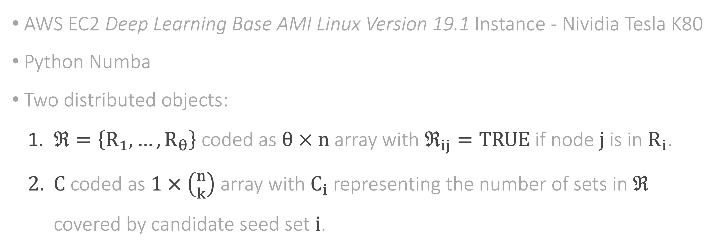
GPU Implementation
AWS EC2 Deep Learning Base AMI Linux Version 19.1 Instance - Nividia Tesla K80
Python Numba
Two distributed objects:
$\text{ℜ}=\left\{R_{1},…, R_{θ}\right\}$ coded as $θ × n$ array with ${\text{ℜ}}_{ij}=TRUE$ if node $j$ is in $R_{i}$.
$C$ coded as $1 × \left({n \atop k}\right)$ array with $C_{i}$ representing the number of sets in $\text{ℜ}$ covered by candidate seed set $i$.

Slide 53
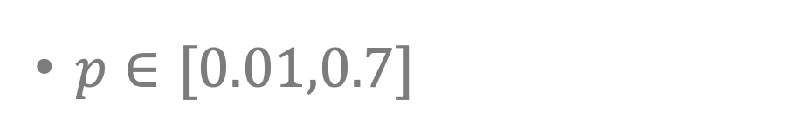
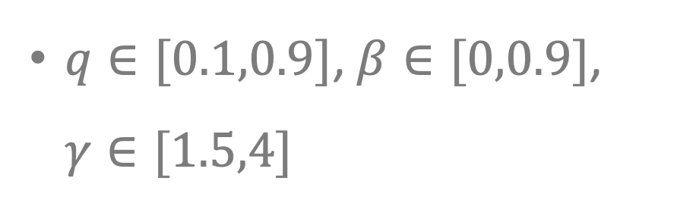
Experiment Parameters
+
+
+
3 Network
Types
29 Parameter Configurations
10 Graph Instances
Erdos-Renyi, Watts-Strogatz, Scale-Free
$q∈[0.1,0.9]$, $β∈[0,0.9]$, $γ∈[1.5,4]$
+
+
+
6-7 Propagation
Probabilities
Network Size 100, Seed Set Size 4
1,880 Total Simulations
$p∈[0.01,0.7]$
180 seconds each
4 days total

Slide 54

Approximations are near optimal
$δ=\frac{σ\left(S_{RIS}\right)}{σ\left(S_{RIS−E}\right)}$

Slide 55
Weak positive relationship between network density and accuracy

Slide 56
Recap
RIS-Exact exploits Reverse Influence Sampling to make exact solutions feasible.
Top approximation algorithms are almost perfect.
Solution accuracy does not depend on network structure.

Slide 57
Thanks

Slide 58
Appendix

Slide 59
References
Kempe, Kleinberg & Tardos (2003). Maximizing the spread of influence through a social network. In Proceedings of the ninth ACM SIGKDD international conference on Knowledge discovery and data mining (p. 137-146). ACM.
Borgs, Brautbar, Chayes & Lucier (2014). Maximizing social influence in nearly optimal time. In Proceedings of the twenty-fifth annual ACM-SIAM symposium on Discrete algorithms (p. 946-957). Society for Industrial and Applied Mathematics.
Li, Smith, Dinh & Thai (2017). Why approximate when you can get the exact? optimal targeted viral marketing at scale. In IEEE INFOCOM 2017-IEEE Conference on Computer Communications. IEEE, 1 – 9

Slide 60
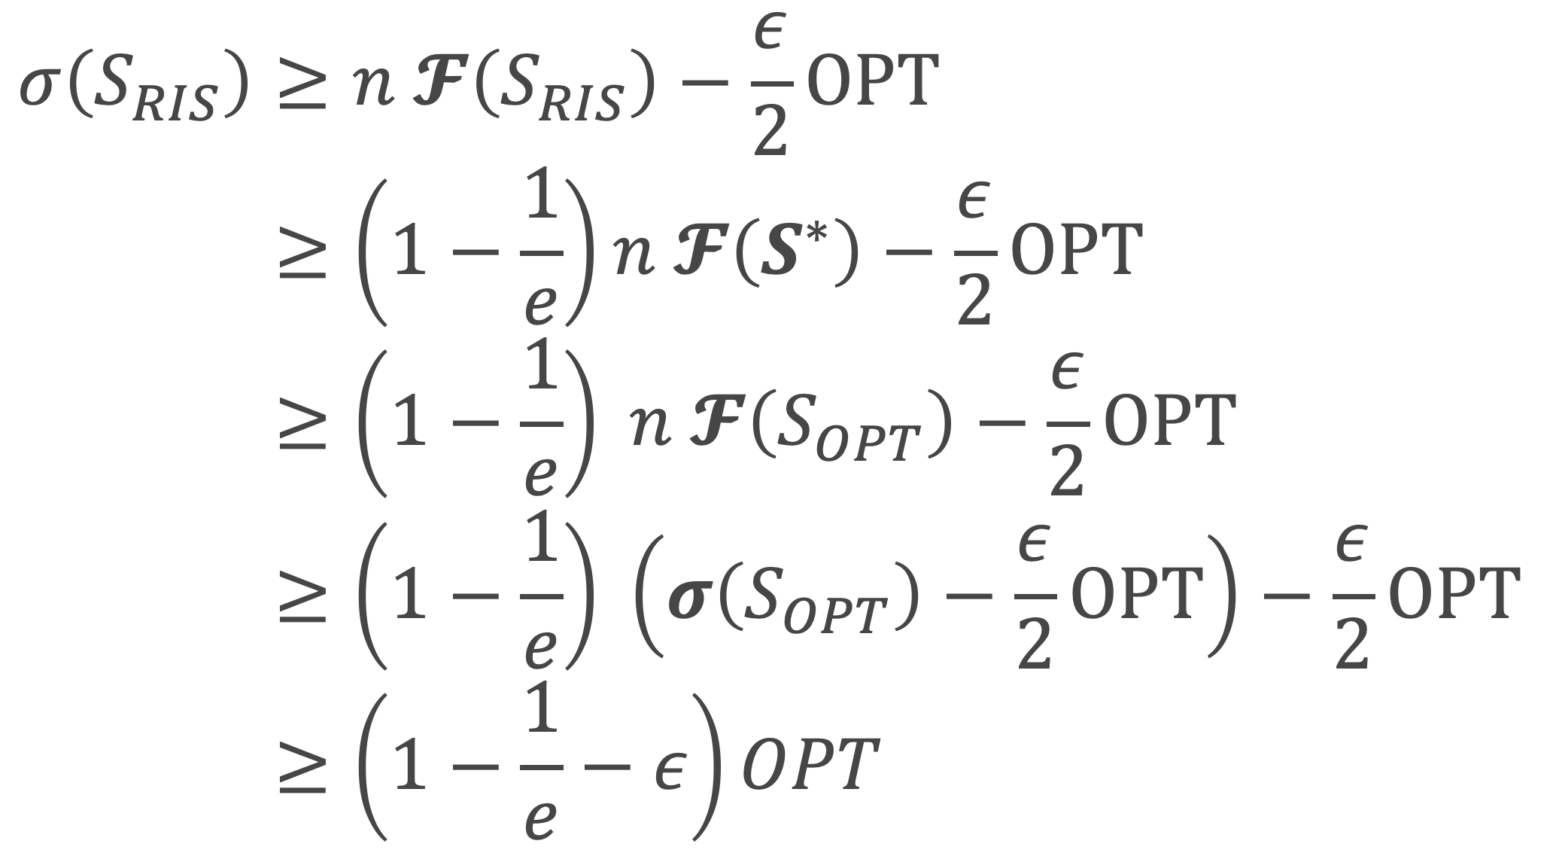

RIS Proof Sketch
$$σ\left(S_{RIS}\right)≥n 𝓕\left(S_{RIS}\right)−\frac{ε}{2}OPT \\ ≥\left(1−\frac{1}{e}\right)n 𝓕\left(S^{∗}\right)−\frac{ε}{2}OPT \\ ≥\left(1−\frac{1}{e}\right) n 𝓕\left(S_{OPT}\right)−\frac{ε}{2}OPT \\ ≥\left(1−\frac{1}{e}\right) \left(σ\left(S_{OPT}\right)−\frac{ε}{2}OPT\right)−\frac{ε}{2}OPT \\ ≥\left(1−\frac{1}{e}−ε\right)OPT$$
[Lemma]
[Greedy submodular error]
[definition of $S^{∗}$]
[Lemma]

